Slide 1
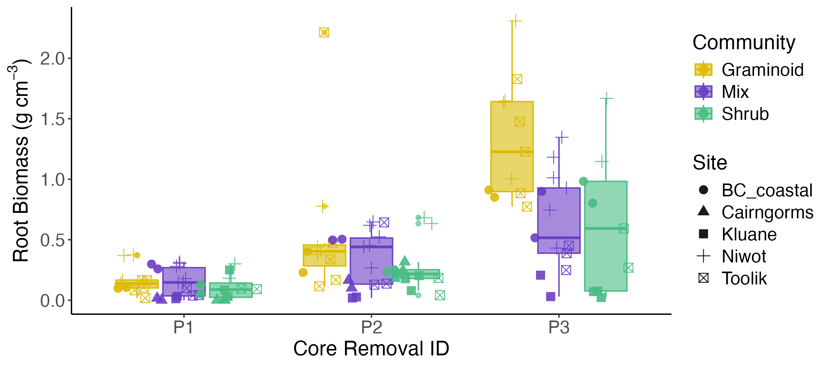
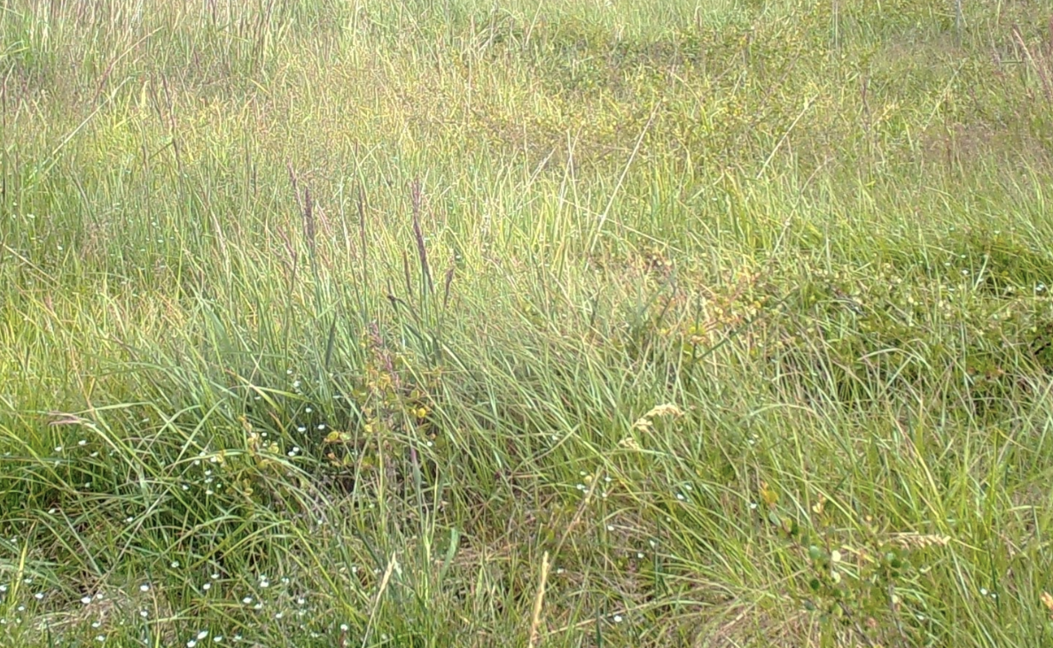
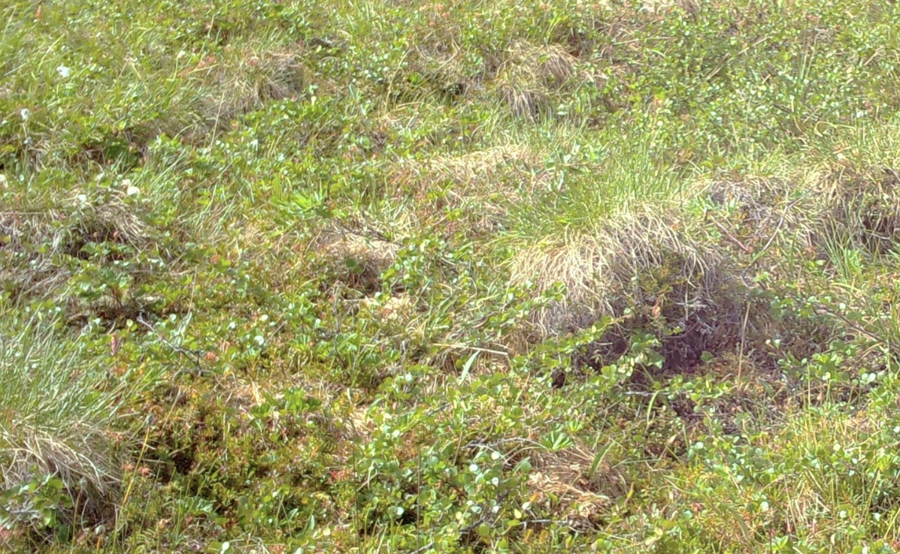
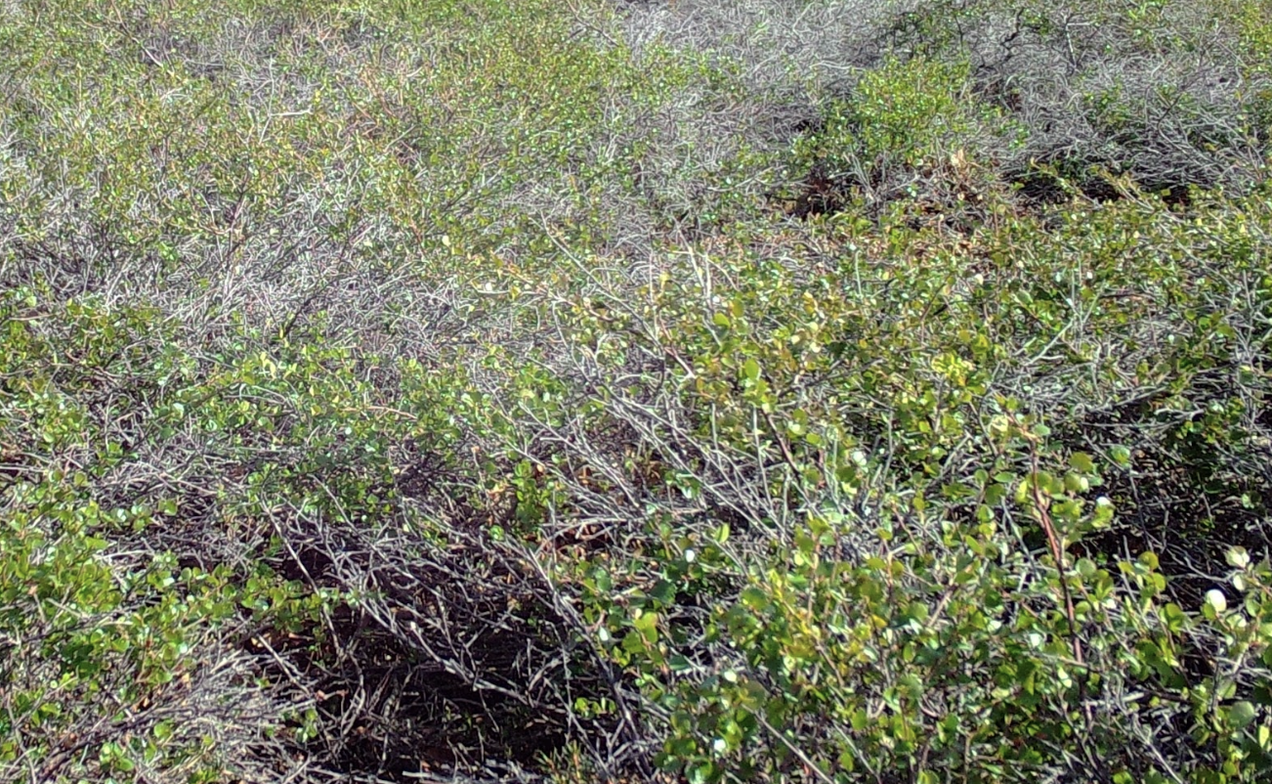
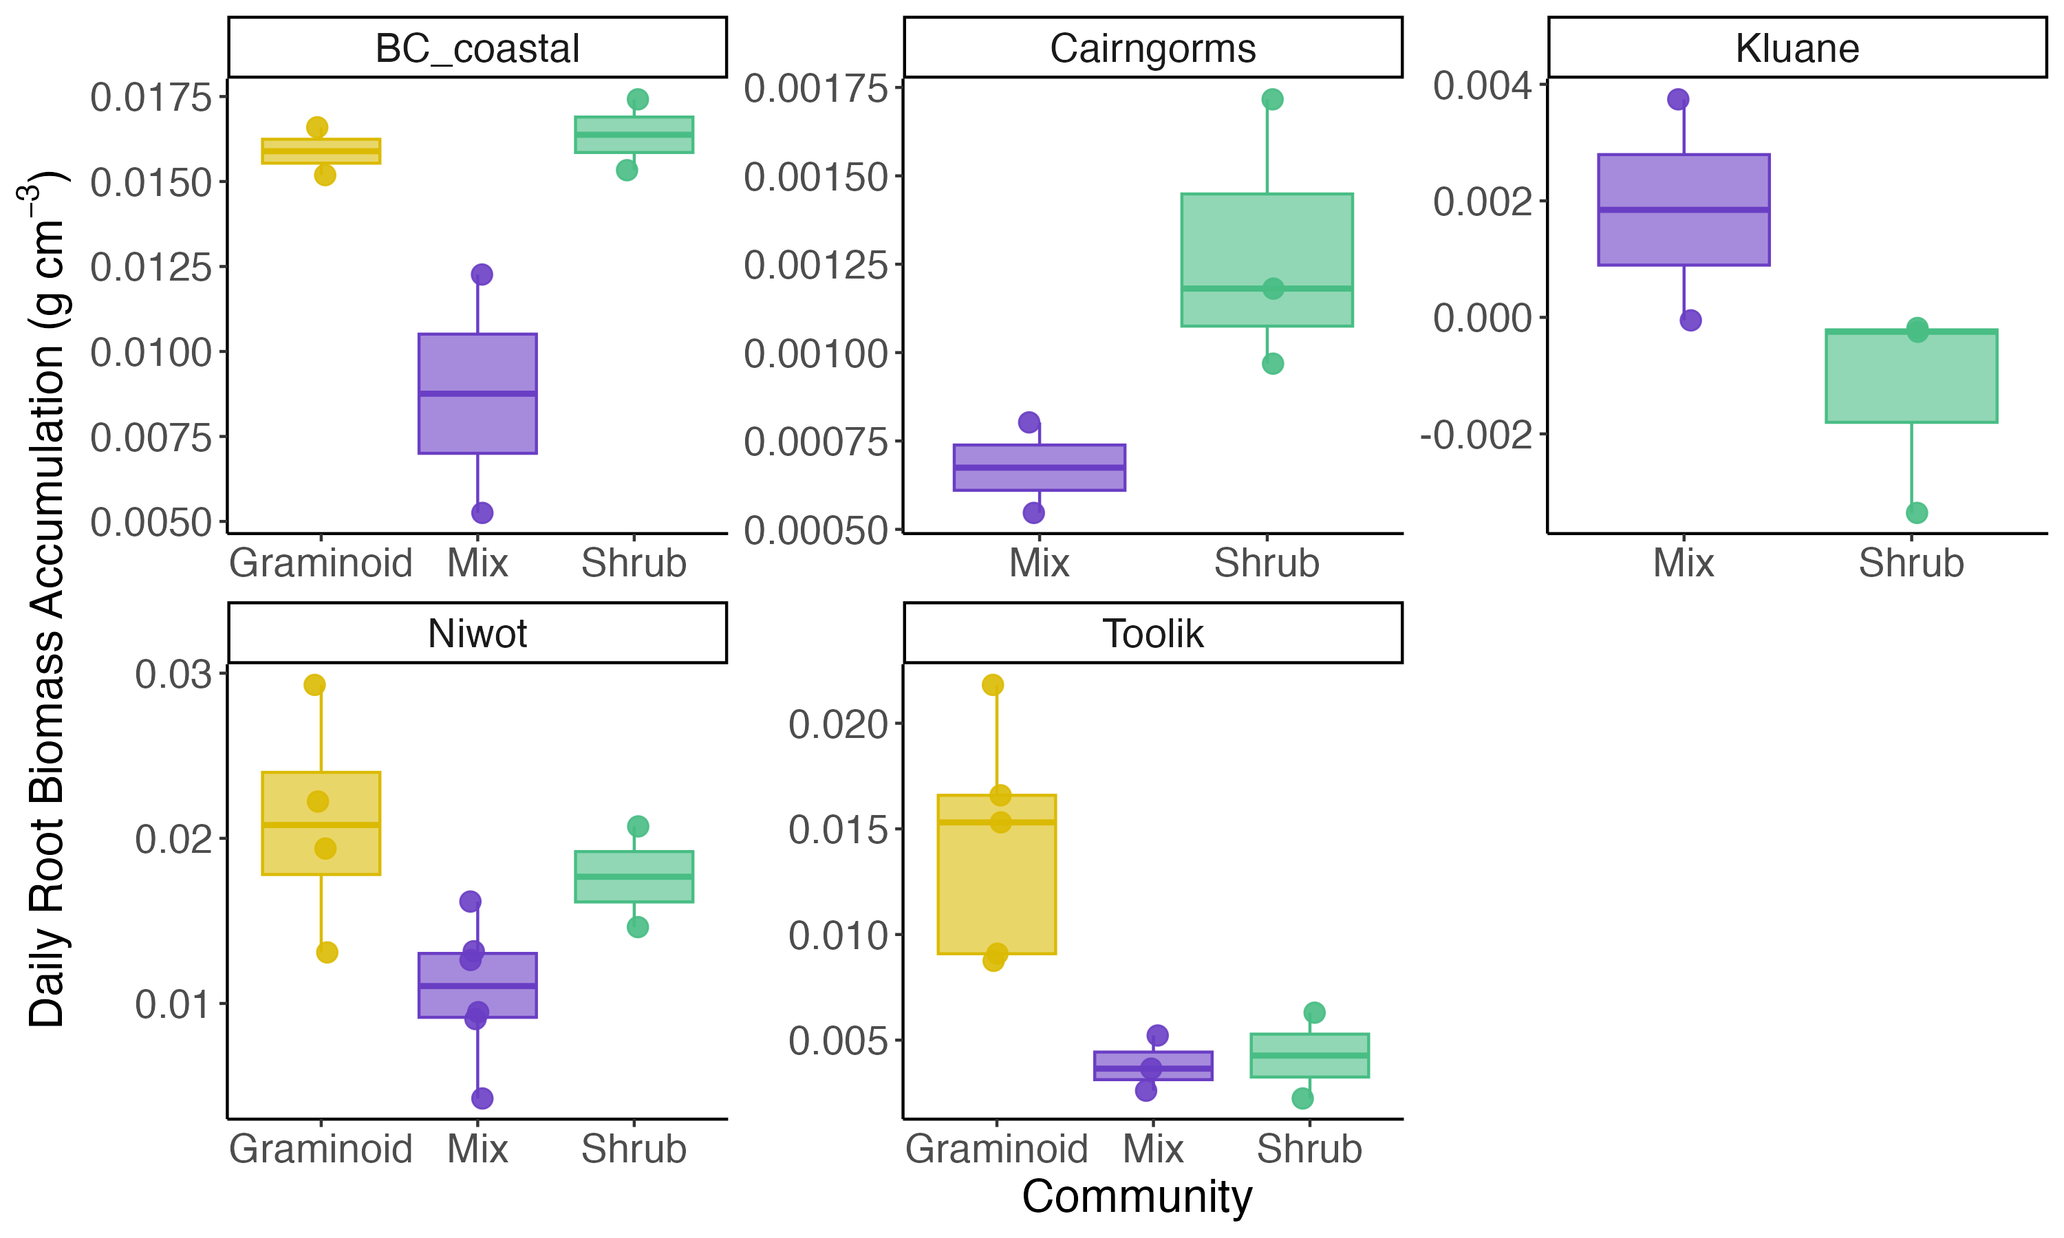
a)
Diff: 0.51
(0.42 – 0.60)
Diff: 0.24
(0.15 – 0.32)
Diff: -0.12
(-0.23 – -0.01)
Diff: - 0.14
(-0.24– -0.04)
b)
Diff: - 0.01
(-0.01– -0.00)
Diff: - 0.01
(-0.01– -0.00)

